Slide 1
Fake vs Real News Identification
Binny Manojkumar Naik

Slide 2



Background
Fake news refers to the spread of misinformation or false information presented as if it were real news. It can have serious consequences for individuals and society, leading to a distorted view of reality, division and mistrust, and even violence. Detecting fake news is important because it helps ensure that people have access to accurate and reliable information, which is essential for making informed decisions and participating in a healthy democracy.

Slide 3
Objective
The objective is to use Natural Language Processing and Deep Learning techniques to detect the fake news article.

Slide 4

Dataset: Fake vs Real News Data
Dataset contains 72,134 labeled news article (1 = real, 0 = fake).
[1] Fake News Detection. https://www.kaggle.com/datasets/saurabhshahane/fake-news-classification

Slide 5
Data Preparation
Remove Stopwords
Removing Null Values
Lowercase all characters
Remove punctuations
Remove non-English words
Random sampling
Number of Train and Test Set Samples after Cleaning
 | Class 0 | Class 1
Training Set | 24,202 (55.2%) | 19,633 (44.8%)
Test Set | 10,372 (55.2%) | 8,415 (44.8%)

Slide 6
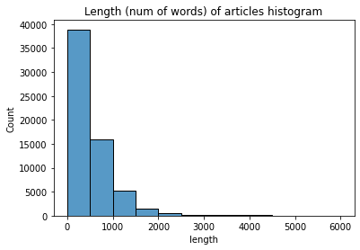
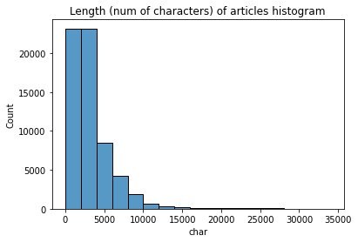
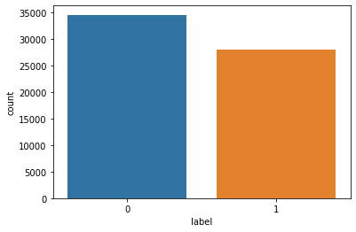
Data Visualizations
Countplot of fake & news article
Histogram of number of words of article
Histogram of number of characters of article

Slide 7


Data Visualizations
WordCloud of Real News Articles
WordCloud of Fake News Articles

Slide 8
Text Representations
Count Vectorization
TF-IDF Vectorization
GloVe Word Embeddings

Slide 9
Models
Neural Network:
Multi Layer Perceptron with Glove Word Embeddings - Baseline
Multi Layer Perceptron with TF IDF Vectorizer
Multi Layer Perceptron with CountVectorizer
Bidirectional LSTM with Glove Word Embeddings
Bidirectional Encoder Representations from Transformers (BERT) Glove Word Embeddings

Slide 10
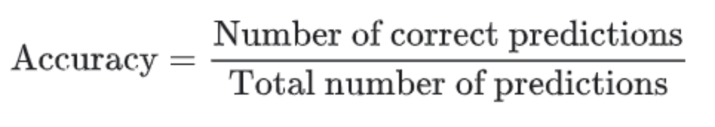
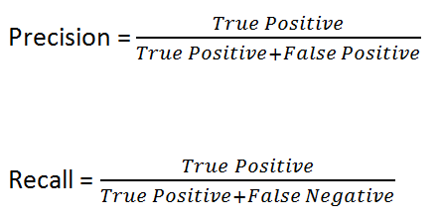
Performance Metrics
AUC & ROC

Slide 11
Results & Learnings
Model | PreProcessing Technique | Test Accuracy
Multi Layer Perceptron | Glove Embedding | 55.50%
Multi Layer Perceptron | TF-Idf Vectorizer | 93.97%
Multi Layer Perceptron | CountVectorizer | 95.57%
BiDirectional LSTM | Glove Embedding | 95.84%
BERT Model | Glove Embedding | 97.55%

Slide 12
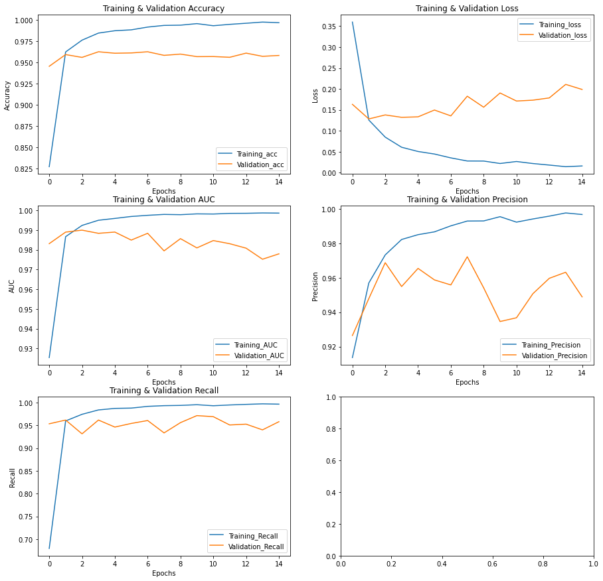
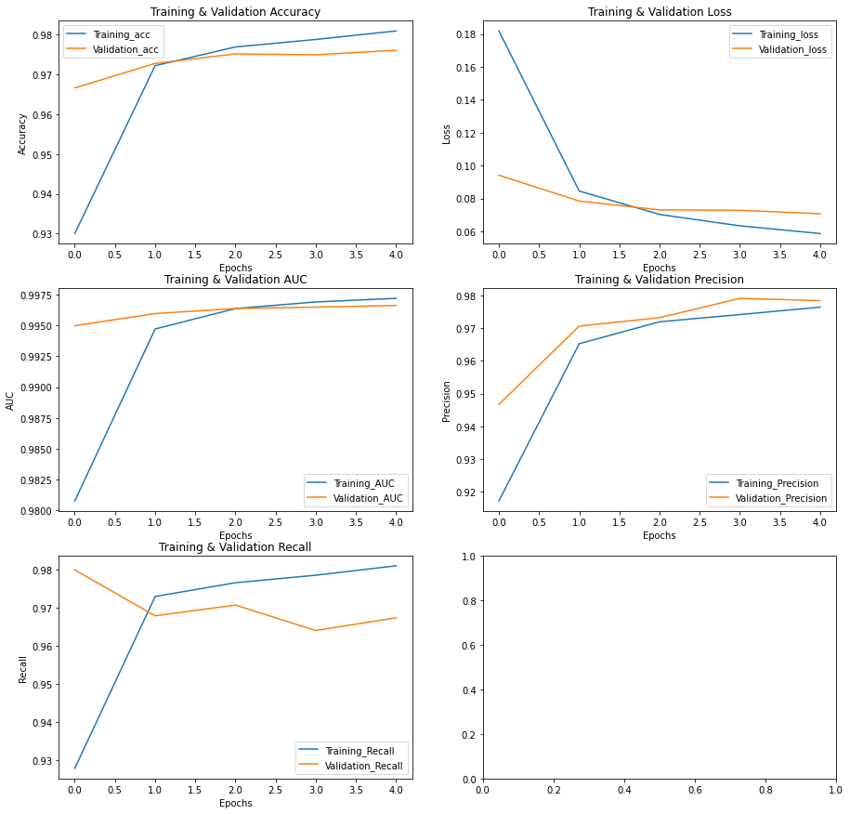
Results & Learnings
BIDirectional LSTM
BERT Model

Slide 13
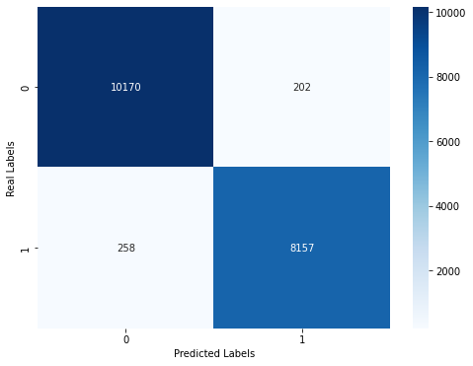
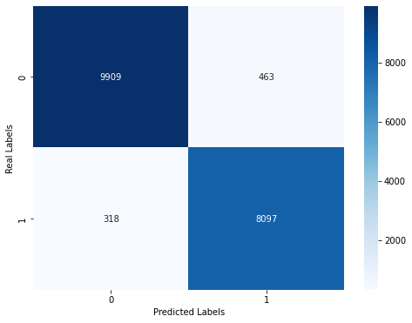
Results & Learnings
BERT MODEL
BIDirectional LSTM

Slide 14
Conclusion
BERT Model is the best fit for this problem in terms of:
Accuracy
Precision
Recall
AUC/ROC
Loss

Slide 15

Codebase
https://github.com/binnynaik30/Fake-News-Detection

Slide 16
Future Work
Implement Word2Vec word embeddings
More feature engineering (e.g., length of news article, type of question)
Implement more complex neural networks (e.g., transformer with attention)

